Slide 1
Social Complexity
Computational Social Science
Lecture 1

Slide 2

Welcome to Computational Social Science
Practicalities: Explain how the module works
Introductions at end
Social science deals with complex problems
Social systems are complex
Problems of interest are increasingly complex
Computational social science provides a set of methods that are suited to complex problems
Contrast with statistical methods
Need to combine data and theory for social science

Slide 3
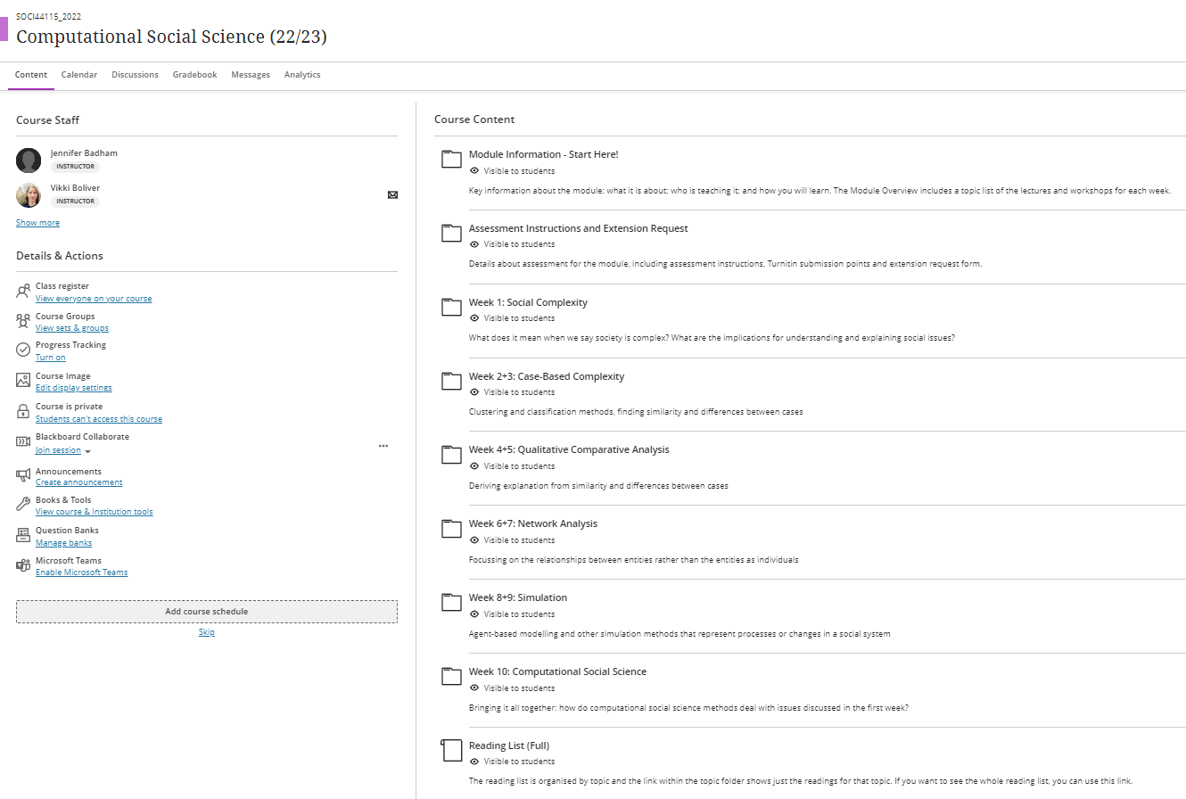
Structure of Module

Slide 4
Teaching Staff (yes, just me)
Who am I?
Dr Jennifer Badham
Teach and convene module
First contact with questions or for support
Talking to me, or about me
Jen (or Jennifer)
Dr Badham
She/her
Contact details
Email: jennifer.badham@durham.ac.uk
Generally respond by end of following business day
Office hours:
By appointment
For in-person, online or Teams chat.
Remember, I may already be talking with another student
Room B3, 32 Old Elvet

Slide 5
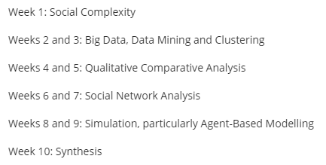
What will you learn about?
First and last lectures discuss key ideas from complexity and methods
Four methods with paired sessions
Lecture ‘about’
Workshop ‘to do’ application

Slide 6




How will you learn? Four modes work together

Slide 7


Lectures
Lectures cover key ideas
Information is organised
Provide scaffolding
Recorded, available within day
Materials uploaded in advance
Do NOT read in advance
Take notes during lecture

Slide 8

Workshops
Workshop for each of four methods
Practice doing the method
Three in R with specialist packages
Download provided script
Run in sections and discuss
ABM workshop in NetLogo
Not recorded
Material uploaded after workshop
Some will complete yourself

Slide 9
Discussion
Active participation in lectures and workshops
Ask questions if unclear
Consider questions posed
Better to think than simply listen to someone else’s answer
Help with workshop errors
Some specific breaks for discussion

Slide 10
Reading
Extensive reading list
Required reading
Insufficient lecture time for everything you should know
Preparatory reading
Advance of lecture, needed to participate
Further reading
For interest and for assessment

Slide 11

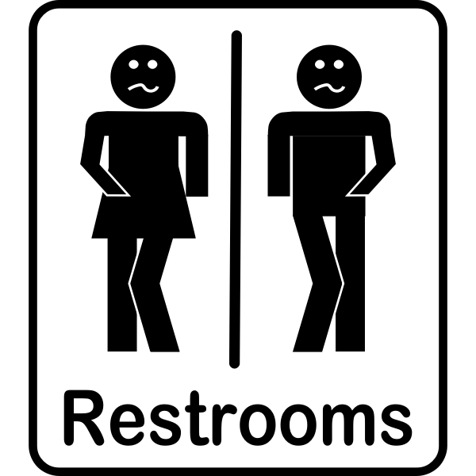




Logistics
Every Thursday (10 weeks)
16:05 to 17:55
2 hours, so break
Note the room changes

Slide 12
One assessment (22 April), plus optional formative (1 March)
Two options, ONE of the following (3000 words)
1/ Compare two (from four in class) methods
Responding to different aspects of a topic you choose
Why that method for that aspect, both strengths and limitations
HINT: Think about methods that could complement each other
2/ Use one of the methods (from four in class)
Choose a question with a relevant dataset / model
Provide context about the question and choice of method
Undertake partial analysis – see assessment description for detail
HINT: Be guided by what is possible with your dataset or model
Lots of information in the assessment description
Extensions and adjustments have forms

Slide 13
Blackboard Ultra run-through

Slide 14
Why are you here?
Please introduce yourself
Name
Course (MARM, MDS, PhD….)
Why did you pick this module?

Slide 15
Introduction
It is a nuisance, but God has chosen to give the easy problems to the physicists.
Lave & March (1993). An Introduction to Models in the Social Sciences. University Press of America. Lanham, MD

Slide 16
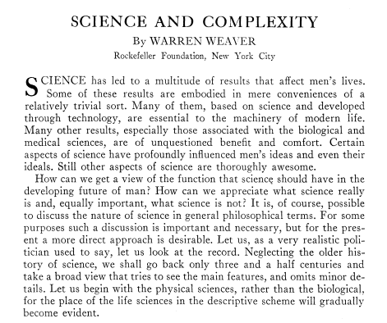
Weaver’s organisation of scientific problems
Edited volume 1947: Scientists Speak
Series of 81 talks from scientists
Presented during intermission of New York Philharmonic Symphony
Organised the material with themes
Introduction adapted for the American Scientist article
Three types of problems
Weaver (1948). "Science and Complexity". American Scientist, 36(4): 536-44

Slide 17


Phase 1 (to about 1900): Problems of simplicity
Physical sciences
Life sciences
Experimental methods
Mathematical relationships between specific variables, eg
Force, motion and acceleration
Motion of single billiard ball
Developed technology
Problems of simplicity not important
Limited quantitative theory
Problems involve multiple variables changing in interdependent ways
Cannot isolate two variables and hold others constant
Collect, describe, classify
Observed correlations

Slide 18

Phase 2 (current, 1948): Problems of disorganised complexity
Statistical methods are powerful
Very large number of variables that behave randomly
Random is why referred to as disorganised
Average behaviour becomes predictable
Relationship between pressure and temperature in gas
Frequency of collisions between millions of billiard balls
Applies even if the simple version not understood
Mortality rates predictable where individual deaths are not

Slide 19

Phase 3 (future): Problems of organised complexity
Consider several billiard balls that start in a row and all pushed directly across the table, rebounding to same place
Would never collide as moving on parallel paths
The starting conditions are organised, not random
Organised complexity problems where "sizeable number of factors which are interrelated into an organic whole"
Common in life and social sciences
Why is one chemical a poison and the mirror image molecule harmless?
How can currency be stabilised?
How to bring about a stable, decent and peaceful world?

Slide 20

Different types of sciences have different types of problems
It is a nuisance, but God has chosen to give the easy problems to the physicists.

Slide 21



Methods are specific to the type of problem
Simple
Experiments
Mathematical formulas
Disorganised complex
Statistics
Organised complex: Promise of future (in 1948) methods
Computing power
Multidisciplinary teams

Slide 22

Understanding complexity

Slide 23
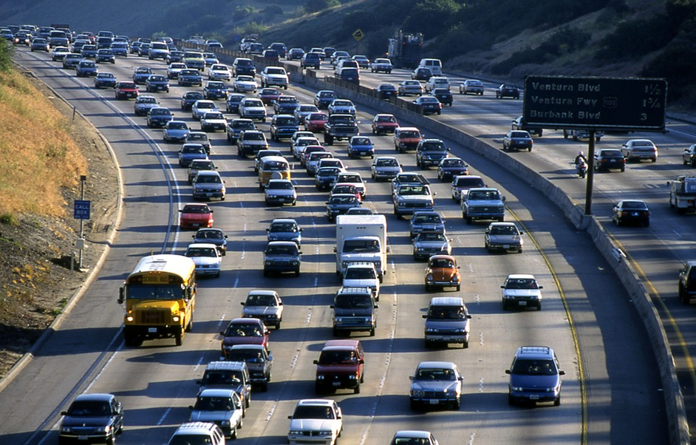
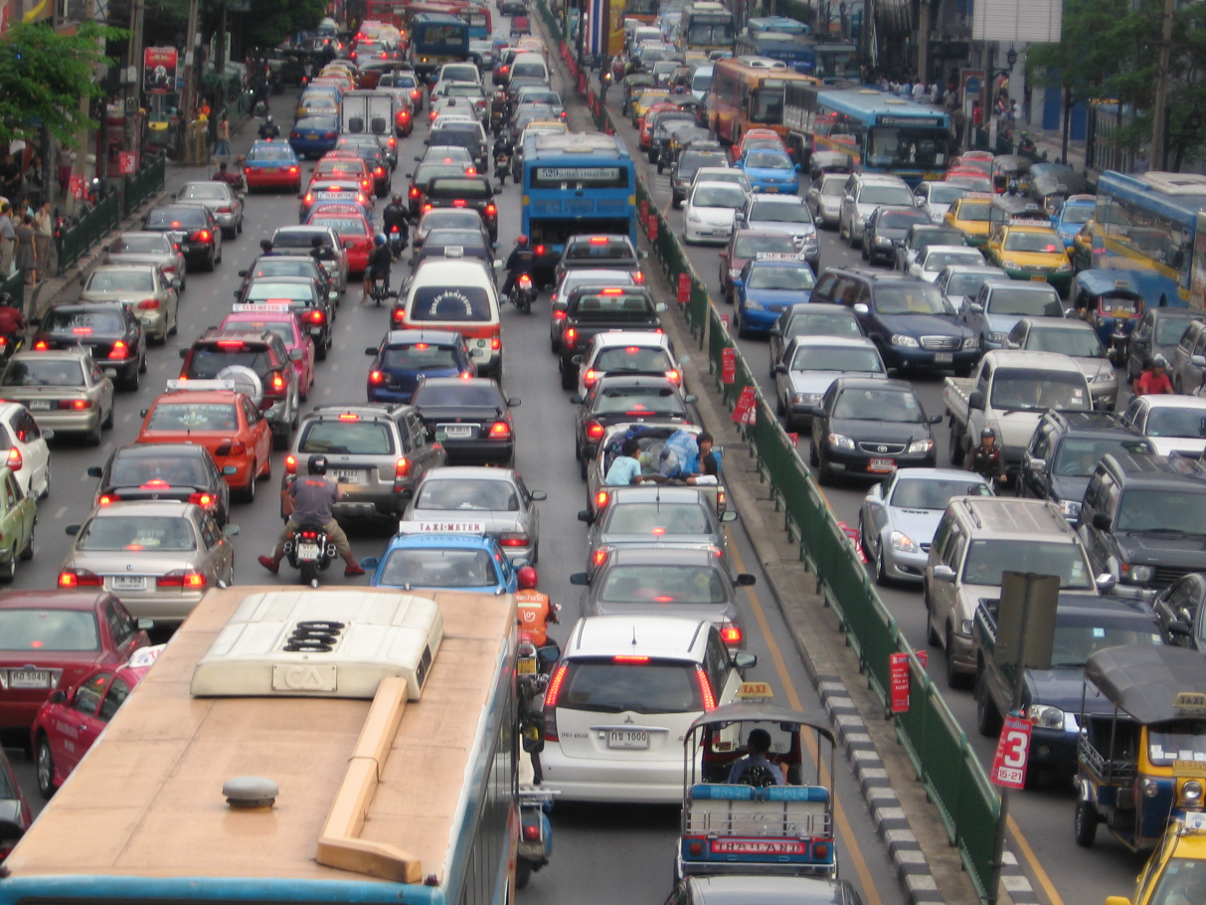
What makes many cars a traffic jam?

Slide 24

Some definitions
sizeable number of factors which are interrelated into an organic whole
Weaver (1948)
that which is compounded out of something so that the whole is one, not like a heap but like a syllable-now the syllable is not its elements, ba is not the same as b and a [perhaps better to think of ‘s’ and ‘h’ and ‘sh’]
Aristotle (~350 BCE), Metaphysics VII:17
Translation by WD Ross http://classics.mit.edu/Aristotle/metaphysics.7.vii.html
Kelso
Complex Systems are systems that comprise many interacting parts with the ability to generate a new quality of macroscopic collective behavior the manifestations of which are the spontaneous formation of distinctive temporal, spatial or functional structures.

Slide 25
Behaviour of system driven by interaction
A system is complex if the system's behaviour of interest is driven by the interactions between the individual parts, not simply the behaviour of the parts independently.
Something ‘more’ than having many parts that are linked in complicated ways
Traffic jam arises from the interactions between cars (drivers really), also interactions with environmental factors such as traffic lights

Slide 26
Example: Standing ovation is cascade behaviour
What if first person to stand was at the back?

Slide 27
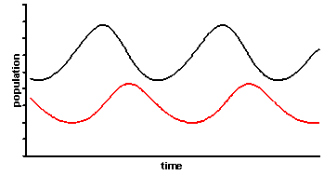
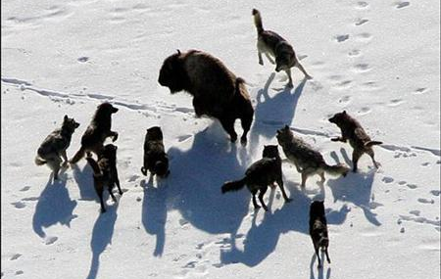
Example: Predator and prey population sizes cycle
prey
predator
Predator cycle follows prey cycle with delay, as prey available the predators have children and that leads to a food shortage

Slide 28
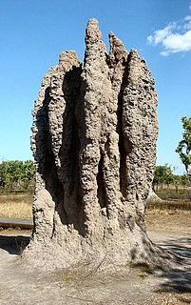
Characteristics: Collective Behaviour
Emergence
Self-organisation
Formal term for the system having properties that the parts do not have
The system exhibits order
Parts (entities) are autonomous, without central control

Slide 29
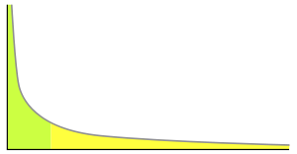
Characteristics: Feedback
Non-linearity
Path-dependency
Small changes with large effect
Entities adapt to the context
Phase changes
System memory (temporal interaction)
Sensitivity to initial conditions
Non-negligible chance of large event

Slide 30
Characteristics: Limited predictability
Fundamental Uncertainty
Emergence
Self-organisation
Non-linearity
Path dependency

Slide 31

NOT all properties in all systems
You may see definitions of complex systems that include these properties
Many complex systems display several of these properties, but only interaction driven causal process is truly required
Some older definitions of emergence describe the emergent behaviour as ‘surprising’, but better to think of it as different

Slide 32
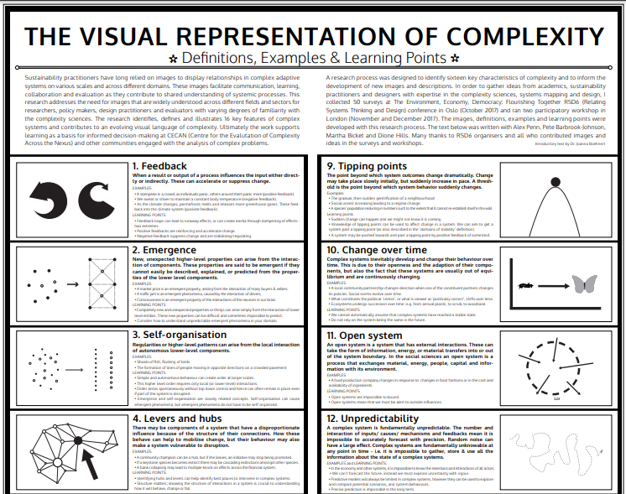
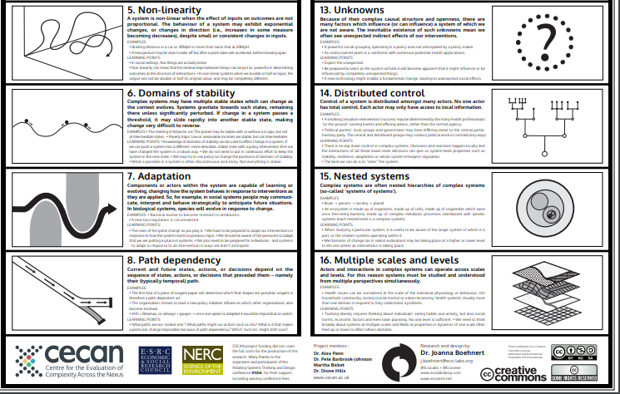
A broader collection of complex problem properties
Boehnert (2018). “The Visual Representation of Complexity". Proceedings of Relating Systems Thinking and Design (RSDX) Symposium

Slide 33
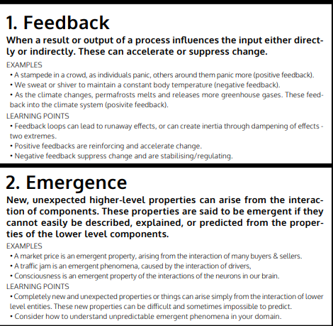
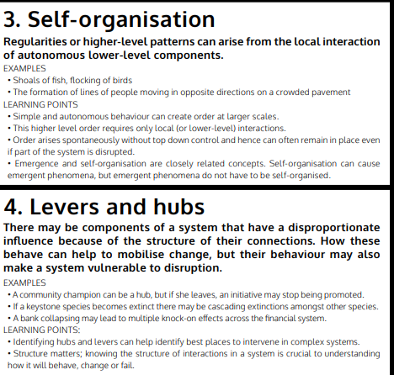

Slide 34
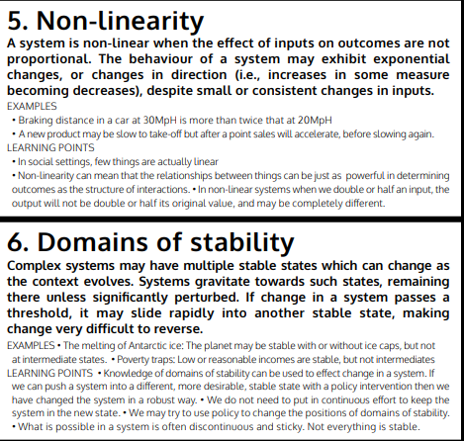
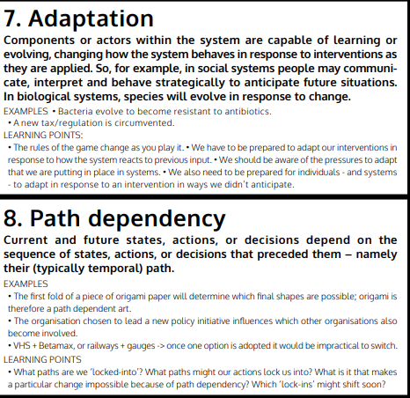

Slide 35
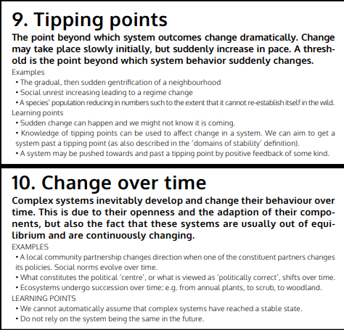
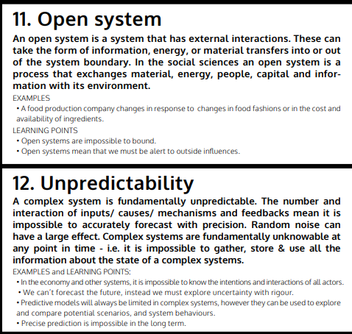

Slide 36
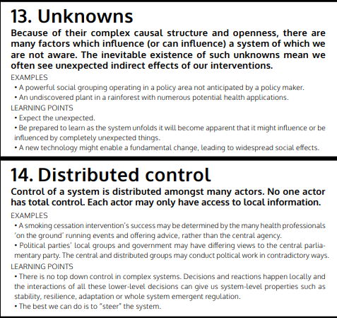
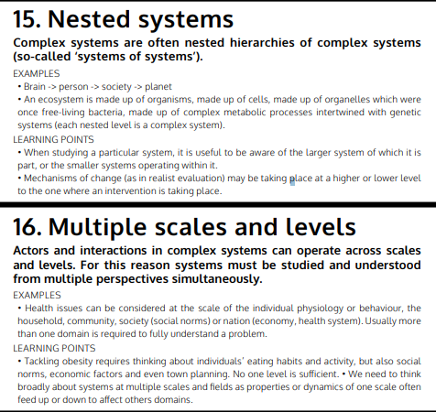

Slide 37
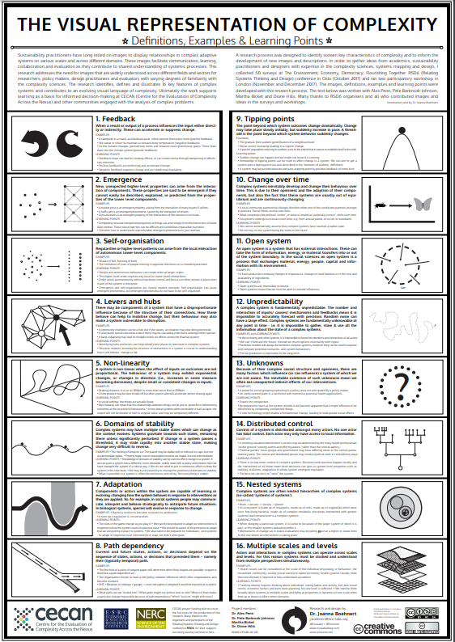
Discussion
How does the example system(s) display complex properties?

Slide 38
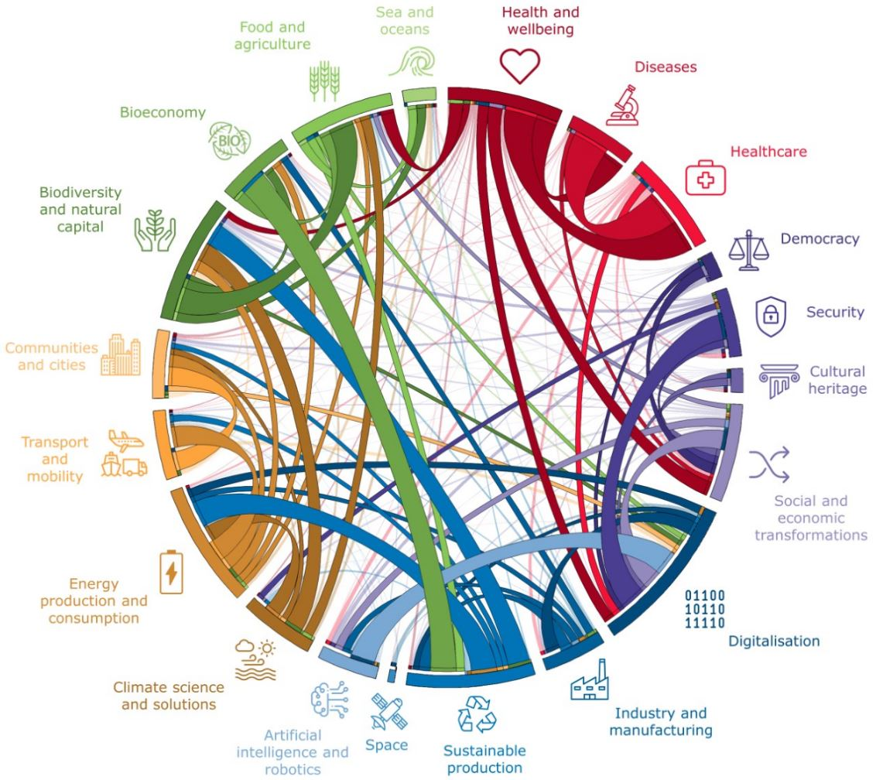
Complexity in social science

Slide 39

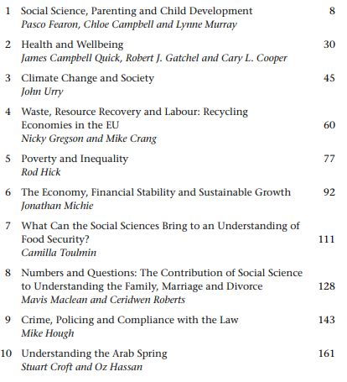
Social science deals with important issues

Slide 40

Social science deals with important issues
Social scientists help us imagine alternative futures
Social science can help us make sense of our finances (including social welfare)
Social scientists contribute to our health and well‐being
Social science might save your life (eg workplace safety)
Social science can make your neighbourhood safer
We need social scientists as public intellectuals
Social science can improve our children’s lives and education
Social science can change the world for the better (eg human rights)
Social science can broaden your horizons
We need social science to guarantee our democracy

Slide 41
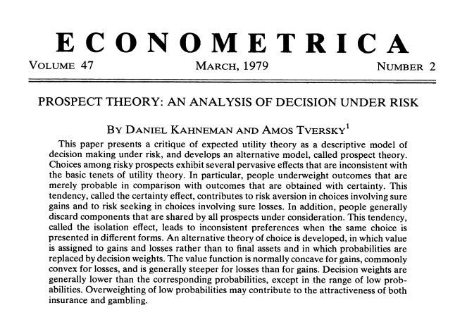
Experimental methods help us to understand people
Example: Many biases in the way people make decisions
Prospect theory
Loss is more important than gain
Small probabilities are overweighted
Definite outcomes are overweighted

Slide 42

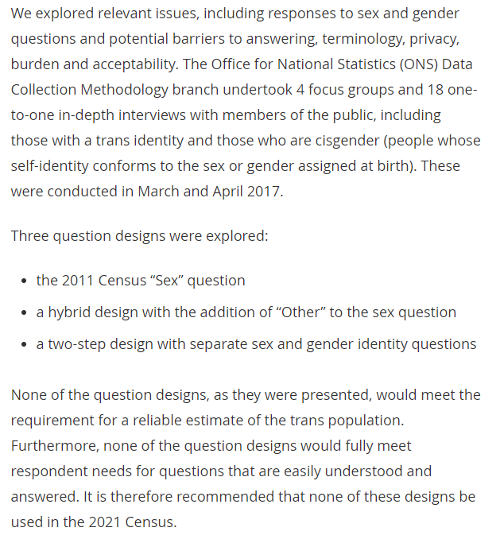

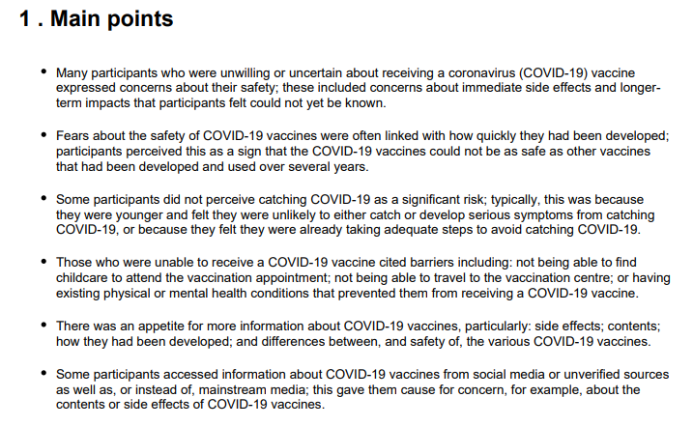
Qualitative methods help us to understand people
How to ask about gender in the census?
Why do people refuse covid vaccination?
https://www.ons.gov.uk/methodology/classificationsandstandards/measuringequality/genderidentity/qualitativeresearchongenderidentityphase1summaryreport
https://www.ons.gov.uk/releases/covid19vaccinationqualitativestudy

Slide 43
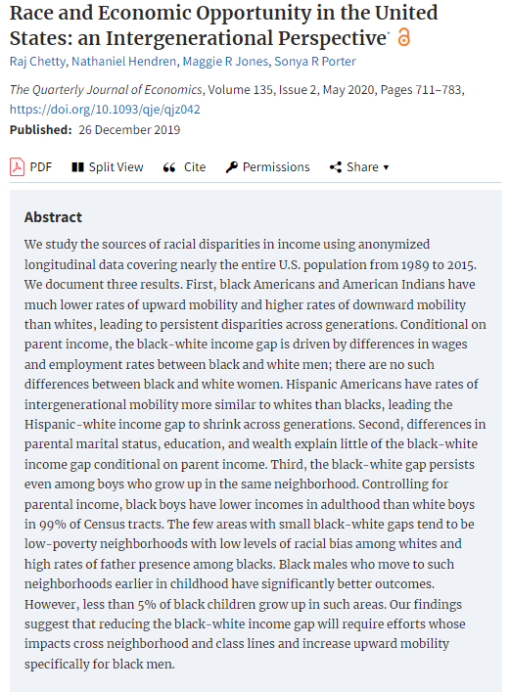
Statistical methods help us to understand society
Example: Understanding disadvantage
In the US, intergenerational mobility differs by race: With parents in the top 20% of income
41% of white children end up in top 20% of income
18% of black children end up in top 20% of income
But a long way to go on improving equity

Slide 44
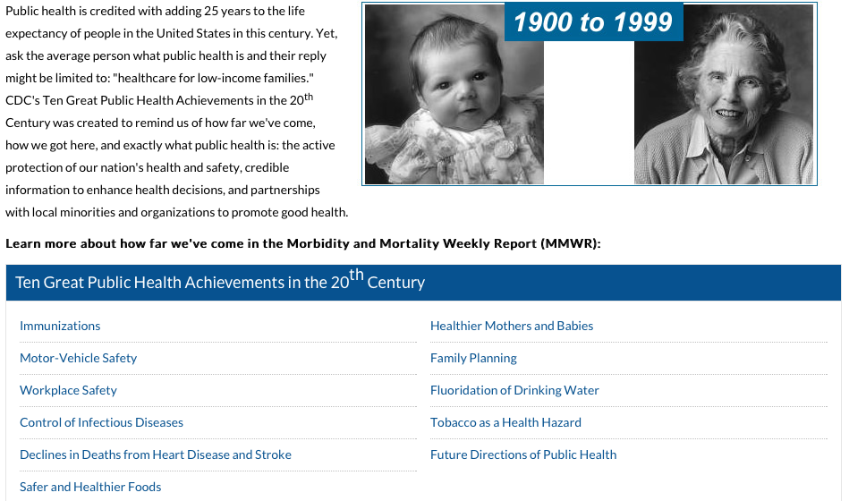

Social science has improved people’s lives
Additional 25 years of life due to public health policies
Details at:
https://sphweb.bumc.bu.edu/otlt/mph-modules/ph/publichealthhistory/publichealthhistory9.html
http://www.cdc.gov/about/history/tengpha.htm

Slide 45
Much of the contribution uses surveys and statistical analysis
National regular surveys
Describe society
Inform government plans
Familiar uses
Estimate economic indicators such as inflation
Measure social inequalities
Track changes in social attitudes
Identify gaps in services
Adhoc surveys and analysis
Government surveys on critical issues
COVID-19 testing
Individual researchers testing a theory
Evaluating interventions
New healthcare technology
Changes in policy

Slide 46

Alternative data sources now available
Social scientists had distinctive methods through latter half of 20th century that justified claims of expertise in social problems
Large transactional data makes such expertise irrelevant for some questions
No need to use proxy variables (eg class) to infer similar expected transactions
Interpretation does not rely on random selection and good response rates

Slide 47
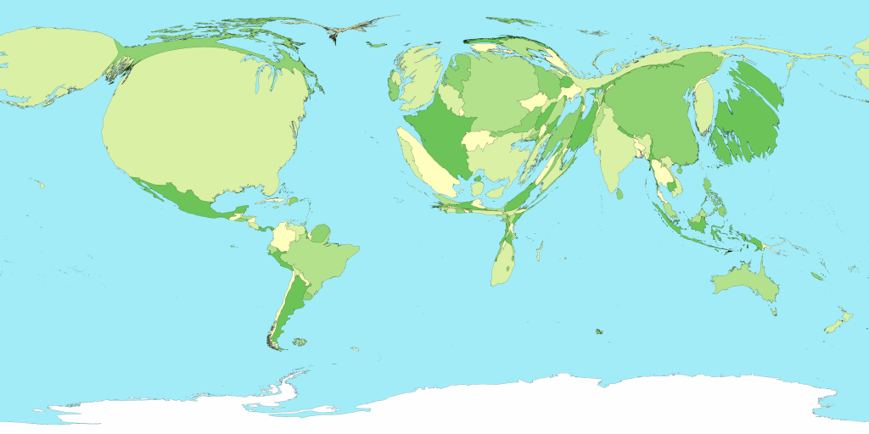
Current social problems less amenable to survey methods
Global population overload
Global warming and climate change
Increasing ecological challenges – access to water, food
Entrenched inequality, within and between countries
Cultural conflict and terrorism
Fast moving epidemics, pandemics
Fragile infrastructure such as supply chain breakdowns

Slide 48
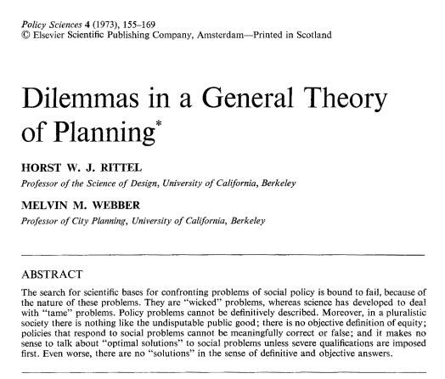
In social policy, may be referred to as ‘wicked problems’
There is no definitive formulation of the problem
Competing perspectives
No specific end point
Solutions are relative; good or bad. The set of potential solutions (or even approaches) is not well described.
Every wicked problem is essentially unique
Interventions cannot be readily undone
No opportunity to learn by trial and error
May be no public tolerance of failure
Every wicked problem can be considered to be a symptom of another problem
Intervening in one area creates other problems

Slide 49
Characteristics of wicked problems are features of complexity
Wicked problems | Complexity framing
Entrenched problems resistant to change | Domains of stability
Poorly formulated with competing perspectives | Open system
Problems are symptoms of other problems | Feedback Interactions

Slide 50
Social domains are interconnected
EU sought suggested missions for their research agenda
Comments by research organisations, NGOs, businesses and other organisations
Contributions addressed multiple intervention domains simultaneously
Mapping of co-occurrence
European Commission, Directorate-General for Research and Innovation, Sorokins, J., Griniece, E., Responses to the call for feedback on “Mission-Oriented Research & Innovation in the European Union” by Mariana Mazzucato : analysis report, Dudek, P.(editor), Publications Office, 2018, https://data.europa.eu/doi/10.2777/870760 (Figure 6)

Slide 51

Survey methods typically ignore context… (1968 quote, but still valid)
As usually practiced, using random sampling of individuals, the survey is a sociological meatgrinder, tearing the individual from his social context… If our aim is to understand people’s behaviour rather than simply record it, we want to know about primary groups, neighborhoods, social circles and communities; about interaction, communication, role expectations, and social control.

Slide 52
Survey methods can include context But analysis is not a simple comparison of variables
Barton (1968) also describes methods to incorporate context
Ask about the characteristics of their friends, co-workers, neighbours, family…
Perceived characteristics can also be compared to real characteristics if both surveyed
Use cluster sampling
Measure for both cluster and individuals
Include ‘interpersonal environment’ in survey
Network data: relationship and influence measures such as frequency/duration of contact
Supplement with information about institutional connections
Enriches the analysis, for example by comparing opportunities
Barton, A. H. (1968). Bringing society back in: Survey research and macro-methodology. American Behavioral Scientist, 12(2),

Slide 53
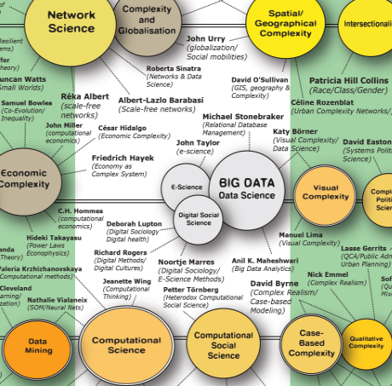
Complexity methods

Slide 54
Why are complex problems difficult?
Reductionist training
Why doesn’t this work?
Focus on ‘the’ (singular) cause
Legal system: Who is at fault?
Scientific training:
Experiments seek to isolate one difference
Narrative with reasons is ‘subjective’
Low in the evidence hierarchy
Randomised control trials report average
Diversity not interesting
Reductionist techniques look at only one part
Predator population has cyclic pattern but reason unclear without the prey
Music cannot be analysed by looking at one instrument in isolation
Expect `cause’ to be near ‘effect’
Even harder if people are involved
Preferences and situation change
Many social issues have multiple contributing factors

Slide 55
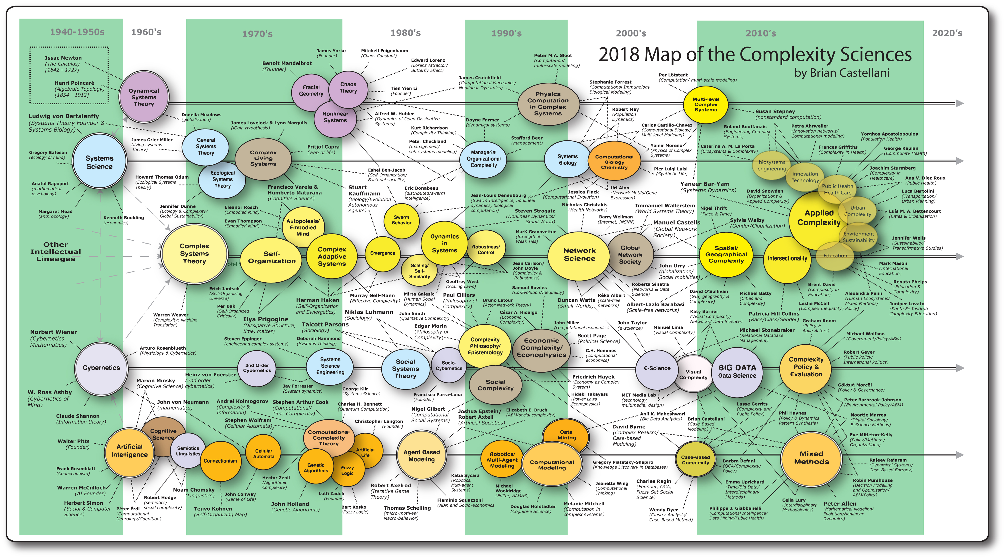
Complexity sciences is not a single field
http://www.art-sciencefactory.com/complexity-map_feb09.html

Slide 56
Some of the complexity oriented theories

Slide 57
What makes social complexity theories different?
Focus on the intersection of factors
Example: intersectionality theory (Patricia Hill Collins)
Study social complexity in systems terms (paths, relationships)
Example: world systems theory (Immanuel Wallerstein)
See the structure of society in network terms
Example: global network society (Manuel Castells)
Interested in how social complexity evolves across time.
Focus is on dynamics, emergence, self-organisation, etc.
Interdisciplinary focused

Slide 58
There are many complexity oriented methods

Slide 59
So, what makes these methods so different?
What they are not
What they are
Not focused on variables
Not focused on simple aggregate averages
Not reductionist
Not static
Not focused on one-size-fits-all models, interventions or services
Use computation and machine intelligence
Hence, computational social science
Focus on cases, interactions and process
What do cases have in common and their differences?
What explanations are consistent with the cases?

Slide 60
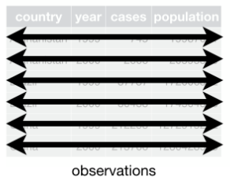
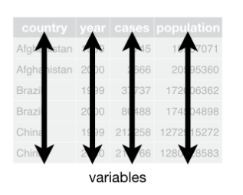
What is a variable?
Dataset contains values about
Cases (observations)
Values of attributes for each case (variables)
The same attributes are measured for each case
Each variable aggregates the values of one attribute for all cases
Wickham, R for Data Science (Figure 12.1)
https://r4ds.had.co.nz/tidy-data.html

Slide 61
What does it mean for two variables to be related?
Variables are associated is shorthand for “the values of two attributes across all cases have a pattern”
Statistical models summarise cases
Big values with big values and small values with small (or vice versa)
Correlation is not causation
Much repeated phrase
Patterns are descriptive, not causative
Variable reports the state of one attribute of some case(s) at some point in time
They are not ‘real’, they cannot exert effects
Highlighting one attribute hides the many ways that the cases are different
Statistical models suggest what may be true for other cases based on the observed cases

Slide 62
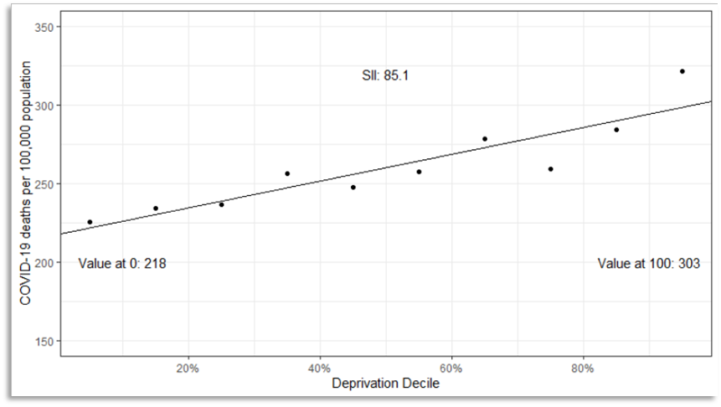
What does it mean for two variables to be related?
Each data point represents a group of local areas and covid mortality is higher in more deprived areas

Slide 63
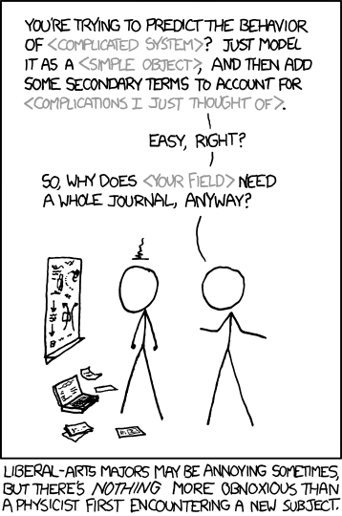
Process is key in complex systems
Statistical models describe an observed pattern but do not explain why that pattern exists
Social reality is organised
Only by understanding ‘why’ can we make claims about cases that differ from those observed
Extrapolating beyond the data
Specific methods, not just ‘add stuff’
Methods are complexity aware
Source: xkcd webcomic [http://xkcd.com/793/]

Slide 64
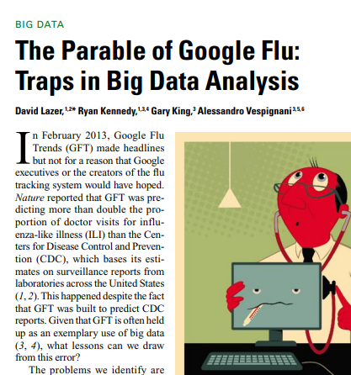
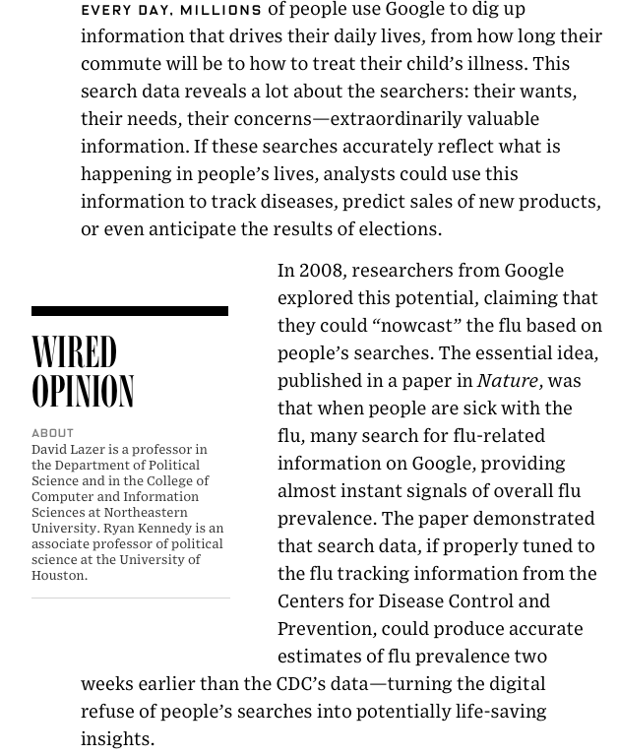
Data are not sufficient, no matter how big
https://www.science.org/doi/10.1126/science.1248506

Slide 65
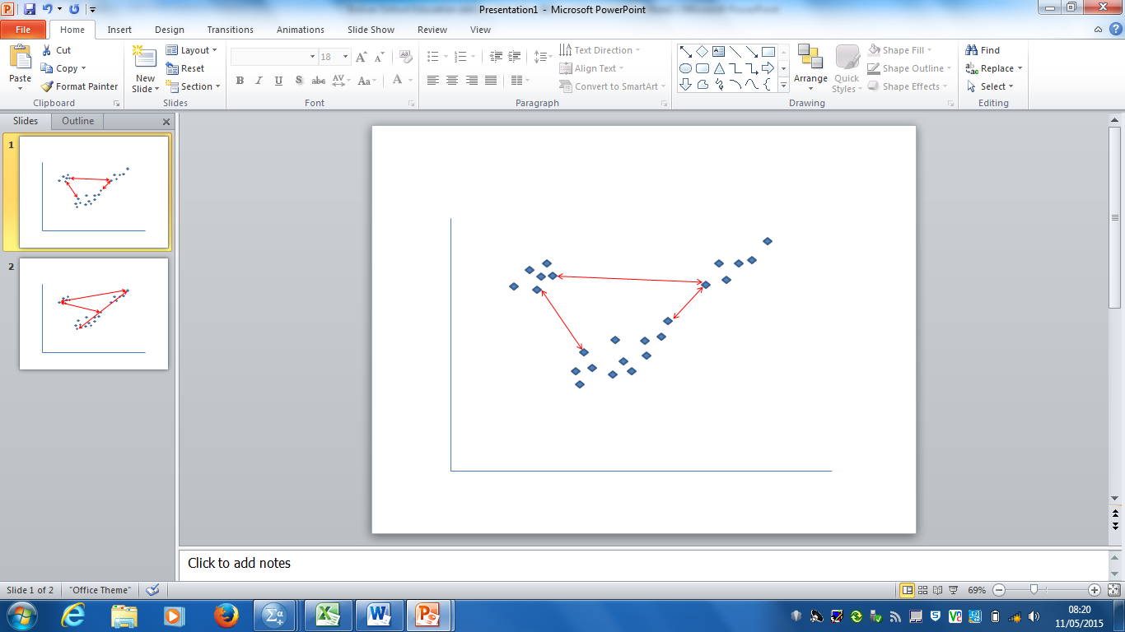
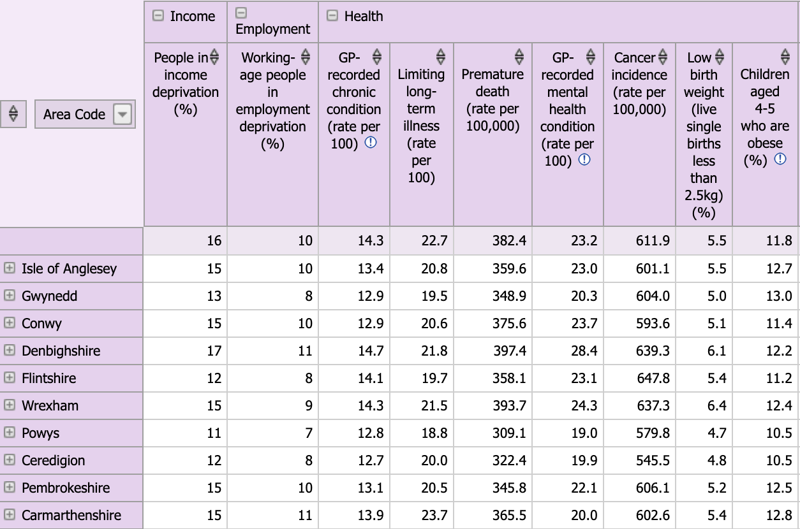
Clustering: Case-Based Complexity
Case →
← Case Profile
Workshop case study: Criminology
Patterns of arrests in USA States

Slide 66
Qualitative Comparative Analysis: Configurational Complexity
Cases with outcome Y
Conditions |  | Cases by outcome
A | B | Y | ➢Y
T | T | 1 | 0
T | F | any | 1
F | T | any | 1
F | F | any | any
Y
A
B
Cases with conditions A and B
Workshop case study: Political Science
Explain survival/breakdown of democracy

Slide 67
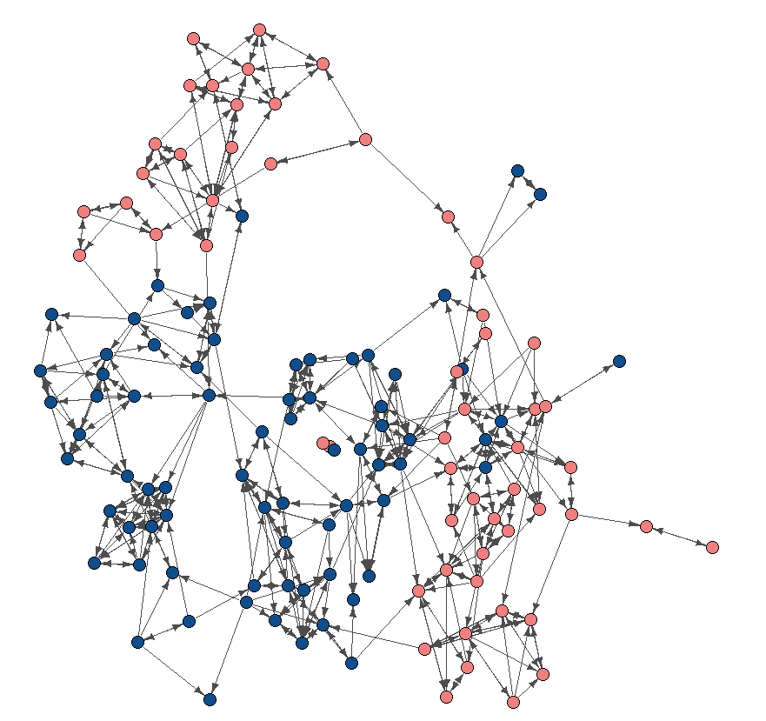
Social network analysis: Modelling relationships
Workshop case study: Sociology
Diffusion of family planning practices

Slide 68
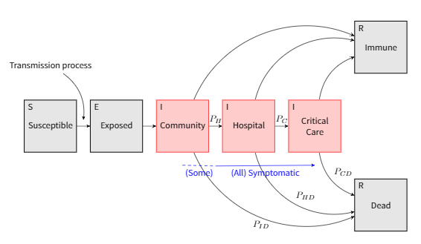
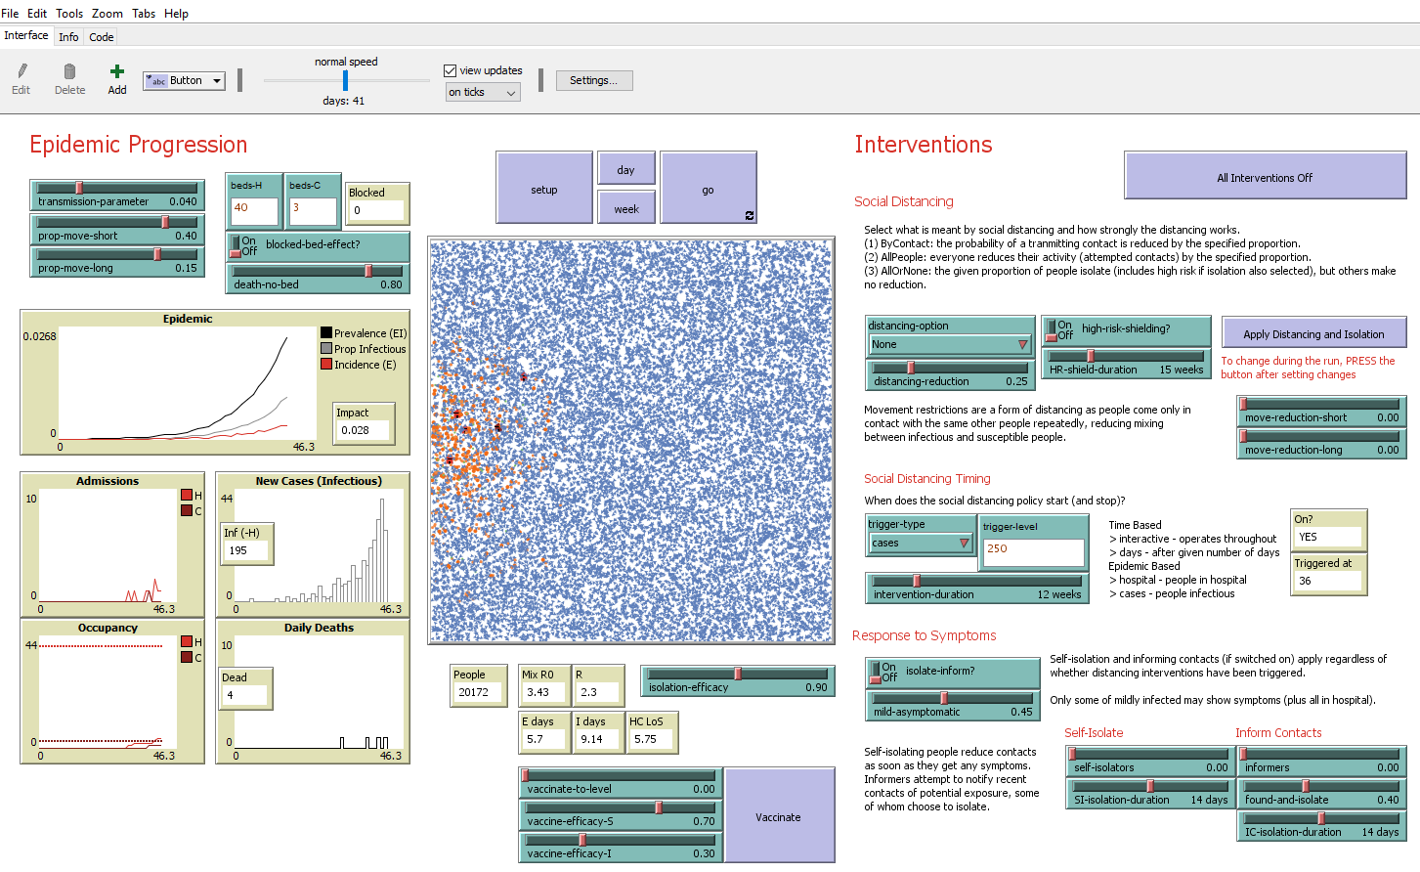
Social Simulation: Modelling processes
Workshop case study: Social Psychology
Conformity and segregation

Slide 69
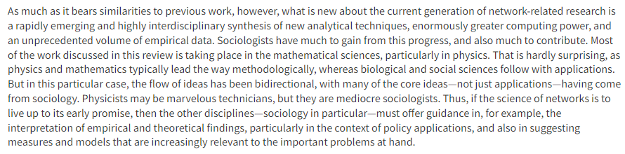
Theory and method work together
Computational Social Science is truly interdisciplinary
Mathematical/computer scientists have analytical skills and training to develop methods and work with data
Social scientists bring ideas, applications and interpretation
Theory organises the ideas and interpretation
Watts (2004), The “New” Science of Networks,
Annual Review of Sociology. 30:1, 243-270

